Slide 1
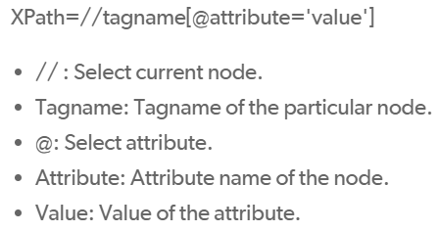
Locating Elements using Selenium by XPath
What is XPath?
XPath is the language used for locating nodes in an XML document.
Can be used on HTML too, so we can use this method to locate elements in a webpage.
How to Use?
Page source of website
Python code to locate “username”
<html>
<body>
<form ="loginForm">
<name="username"="text" />
</form>
</body>
</html>
username = driver.find_element_by_xpath(
"//form[input/@name='username’]”
)
Look under “form” element…
To find an input element with the name of “username”
This is generic format to locate by XPath:
Python code to key into username field
username.send_keys(“USER123")
Use this code to key “USER123” into the username field that you located above.
References:
https://selenium-python.readthedocs.io/locating-elements.html
https://pythonspot.com/selenium-textbox/

